Slide 1
www.TheRestorationMovement.com

Slide 2
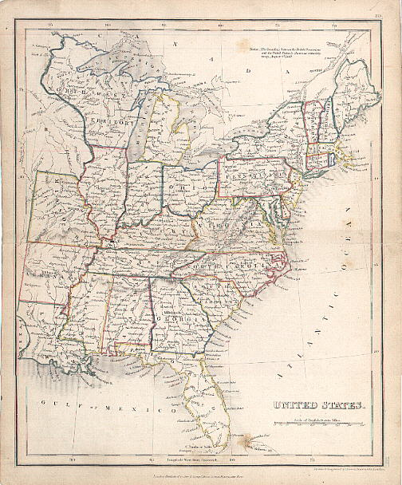
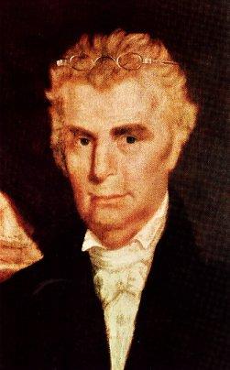
The Work And Influence Of Barton W. Stone

Slide 3
Background To The Kentucky Revival
In 1796, 97 Many Denominational Preachers Questioned Their Backgrounds
One Preacher Wrote That His Sin Was Greatest Among Sinners Deserving God’s Wrath
Another Wrote, “If People Are Spotted With Sin, I’m Spotted All Over.”
One Preacher Thought The World Was Doomed Waiting On The Wrath Of God To Be Revealed
Others Thought Themselves Unworthy Of Any Blessing From God
Everyone Was Doomed And There Was Nothing That Could Be Done About It
These Were The Result Of Calvinism In Presbyterian Teaching In Kentucky In Late 18th Century

Slide 4
Kentucky Revival & James McGready (1760-1817)

Slide 5
Red River Meetinghouse Logan County, Kentucky Birthplace Of The Kentucky Revival & 2nd Great Awakening

Slide 6
Barton Warren Stone
1772-1844

Slide 7
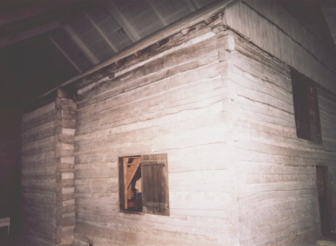
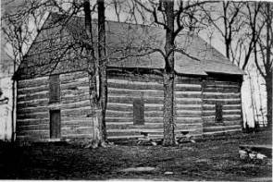
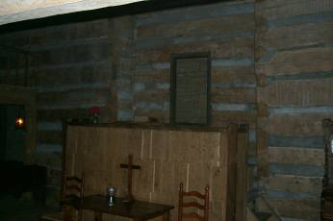
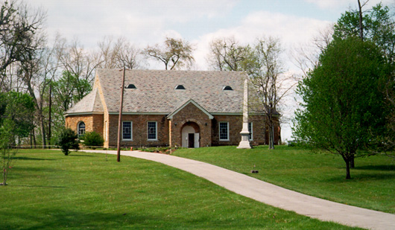
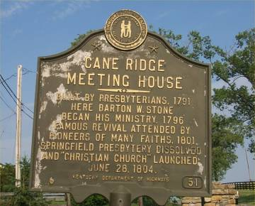
Cane Ridge Revival August 14-19, 1801

Slide 8
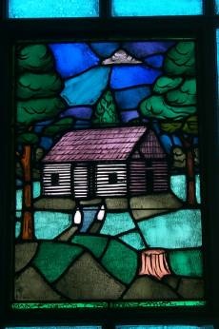
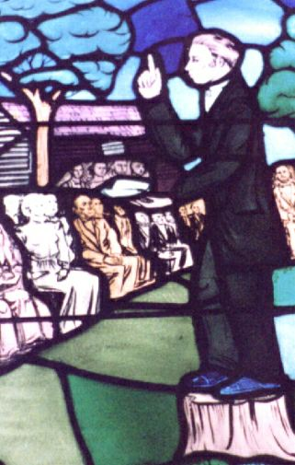
Cane Ridge Meetinghouse

Slide 9
Rejection & Restructuring
Barton Warren Stone

Slide 10
Restoration
Signing of the Last Will And Testament of the Springfield Presbytery, 1804

Slide 11
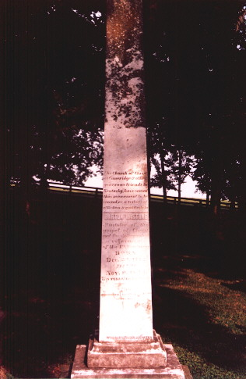
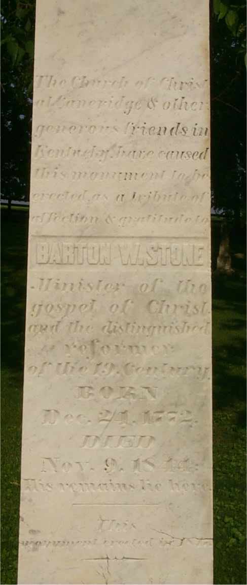
Cane Ridge Cemetery

Slide 12
Grave Of William Rogers
William Rogers
BORN IN
Campbell Co. VA
July 7, 1784. Removed With His Father To Caine Ridge Bourbon Co. Apr, 1798
United With The Church Of Christ At Cane Ridge In 1807
DIED Feb. 15, 1862.
In The 78 Year Of His Age.
He was the friend of God

Slide 13
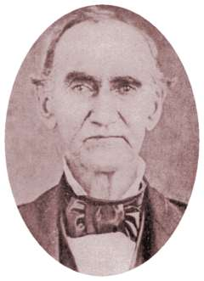
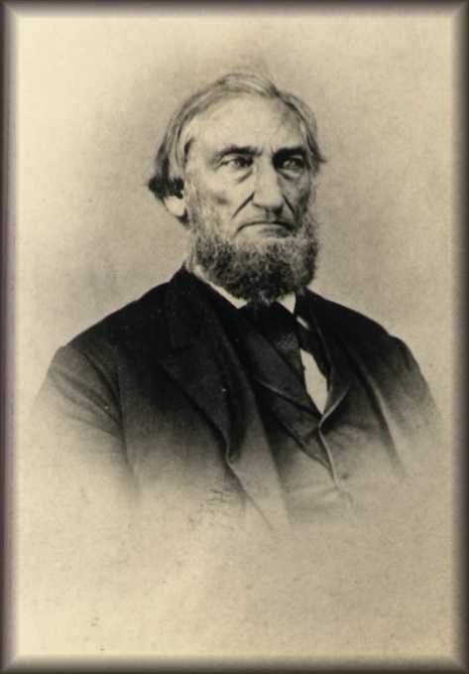
Stone’s Influence
John T. Johnson
1788-1856
John Rogers
1800-1867
B.F. Hall
1803-1873

Slide 14
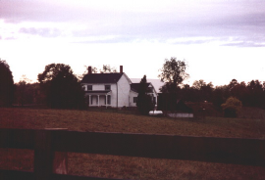
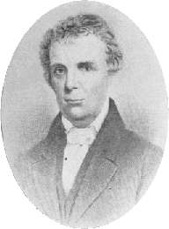
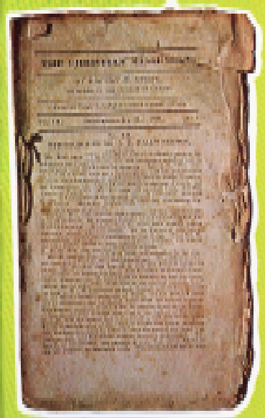
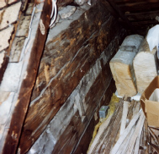
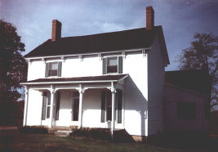
The Christian Messenger 1826-1844
Began in the basement of his Georgetown farm in 1826

Slide 15
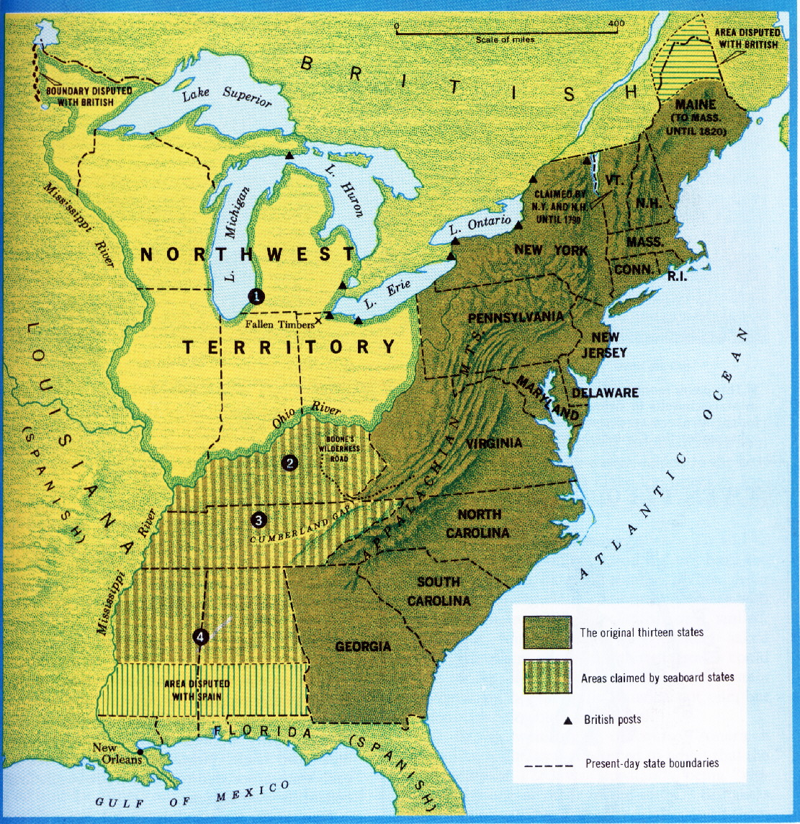
The Influence Of Thomas & Alexander Campbell
1809, Thomas & Alexander Campbell, Bethany, Virginia

Slide 16
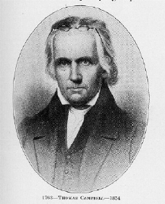
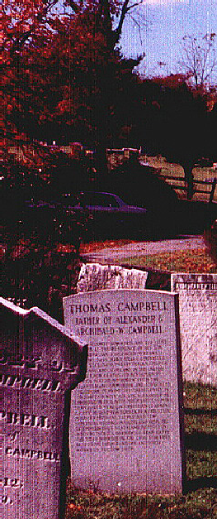
Thomas Campbell 1763 - 1854

Slide 17
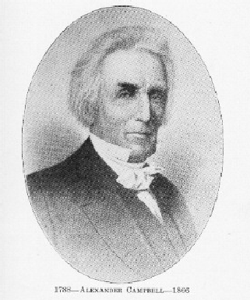
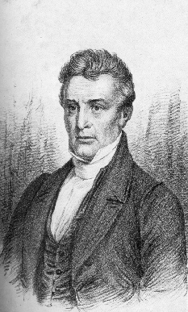
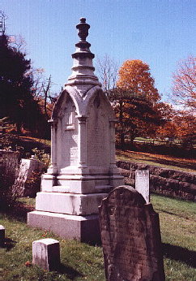
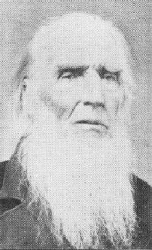
Alexander Campbell 1788-1866
Seasoned Preacher
Around Age 26
Before His Death
Buried At God’s Acre

Slide 18
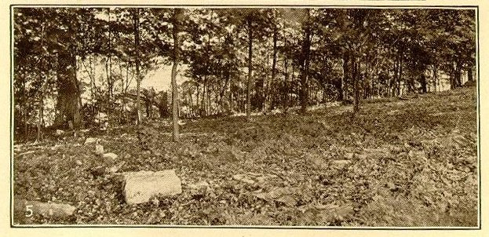
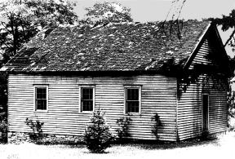
Brush Run 1811

Slide 19
Baptism In Buffalo Creek 1812
Elder Matthias Luce 1764-1831
In Buffalo Creek at the Grist Mill on David Bryant’s farm. Memoirs, 1,371,372

Slide 20
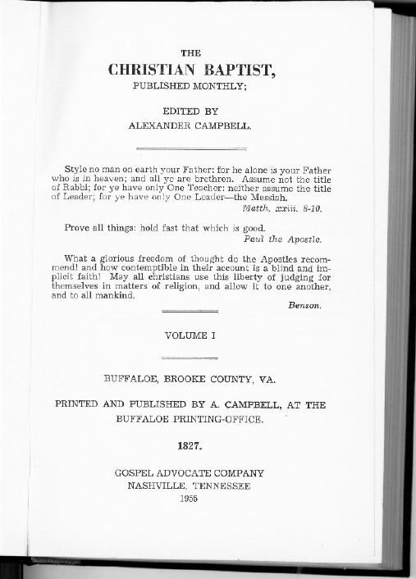
Journals
1823-1830
1830-1870

Slide 21
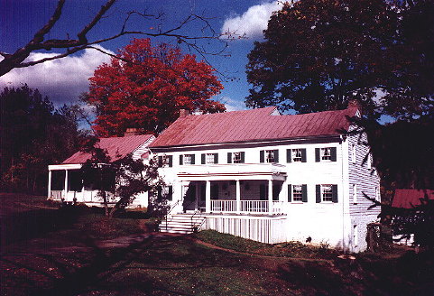
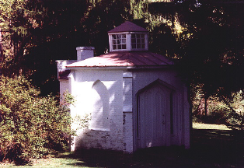
Campbell’s Bethany Home & Study
Light From Above Study

Slide 22
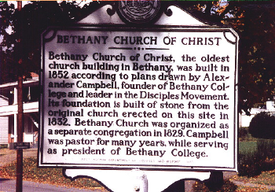
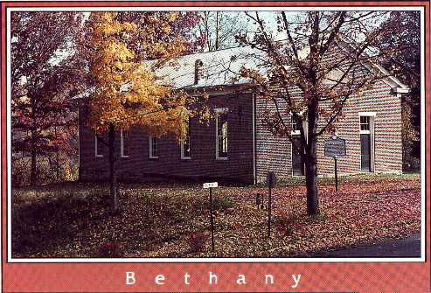
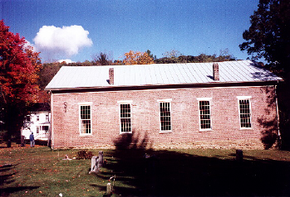
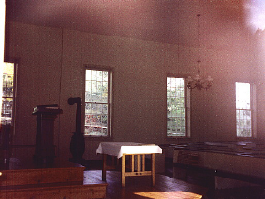
Bethany
Brush Run Church moved to Bethany in 1829, calling itself simply, Bethany Church of Christ. This structure was built on the old foundation in 1852, It sits between Bethany College and the Campbell Mansion. Many Preachers other than Campbell preached here: Walter Scott, Raccoon John Smith, D.S. Burnett, and J.W. McGarvey, many others
Church of Christ

Slide 23
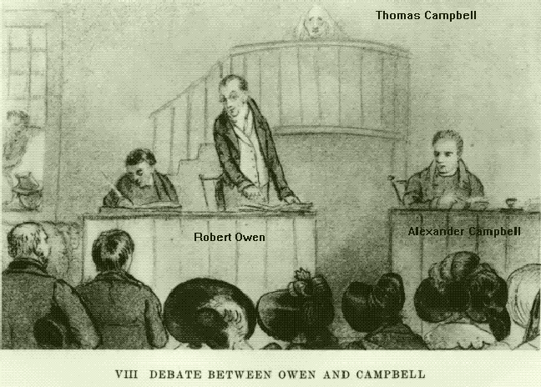
Debating And Its Contribution To Restoration
Six Debates:
John Walker – Presbyterian – Baptism – June 19-20, 1820
W.L. McCalla – Presbyterian – Baptism – October 15-21, 1823
Robert Owen – Skeptic – Social Reform/Existence Of God – April 13-21, 1829
Obadiah Jennings – Presbyterian – Baptism – December 25, 1830
Bishop John B. Purcell – Education/Catholicism – January 13-21, 1837
N.L. Rice – Presbyterian – Baptism – Nov. 15, 1843

Slide 24
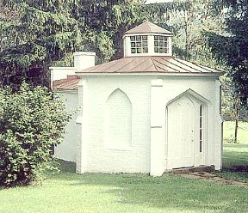
Education – Bethany College

Slide 25
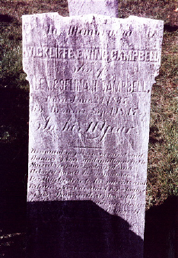
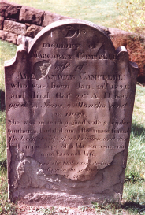
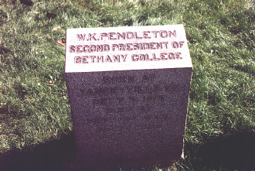
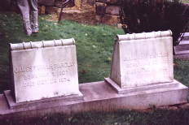
Alexander Campbell Died In 1866 Buried In God’s Acre

